Slide 1
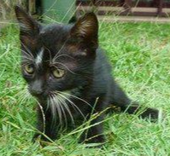
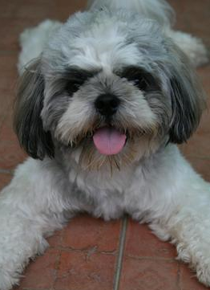
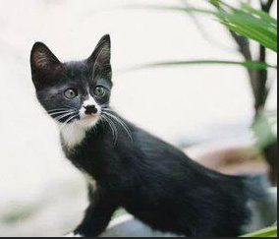
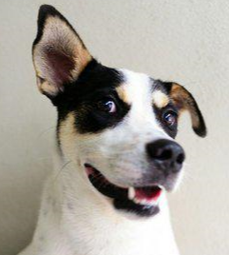
Pet Adoption Final Report for Capstone I
John L Parsons

Slide 2




Business Objectives
Create a Champion Machine Learning Model to predict which animals are most likely to be adopted and make the necessary changes to minimize shelter length.
Create a Cox PH Fitter Lifeline Model and Kaplan-Meier Plots for an in-depth analysis of specific cohorts to maximize adoption rates.
Text Analysis will be used on the Name attribute with the Naïve Bayes Model to determine if the animals name will increase its chance of being adopted from the shelter.

Slide 3
Dataset summary
The Pet Adoption Training Dataset from the Kaggle Competition will be used to meet the business objectives.
The Pet Adoption Dataset contains a total of 24 attributes and 14,993 rows of data.
The list of all 24 attributes can be seen in Figure 1 (next slide).
This dataset had three types of data classifications listed in Python. The majority of these were Int64 for 19 variables, four were listed as Objects (Name, Description, PetID and RescueID) and only one was listed as a Float64 (PhotoAmt).

Slide 4
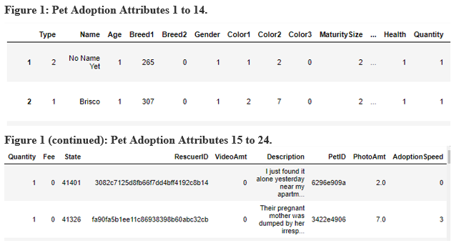
Pet Adoption Dataset
Figure 1 is a list of all 24 attributes that will be used for this project from the training Kaggle Data set to meet the business objectives. The Pet Adoption dataset can be found from the following link: https://www.kaggle.com/c/petfinder-adoption-prediction

Slide 5
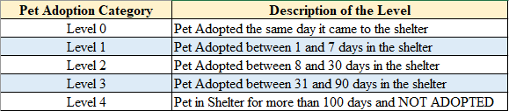
Target Variable
AdoptionSpeed attribute is an ordinal variable that shows the length of time a pet stays in the shelter and is the target variable.
AdoptionSpeed has a total of 5 levels based on the age in months an animal enters the shelter. The AdoptionSpeed description can be seen in Figure 2.
Figure 2

Slide 6
Data Wrangling missing variables
The training data set did not have any missing values for the numeric variables in the dataset.
There were two non-numeric variables that contained missing values and this was the Name and the Description of the pet.
The Name variable had a total of 1,257 missing values and the Description only had 12 missing values. The missing rows will be removed for the text analysis section of this study.

Slide 7
Data Wrangling outliers
Age and Breed1 variables has several outliers and were transformed to reduce the affect these outliers had on the models.
Age attribute will have two types of transformations to reduce the number of outliers:
The Age attribute will be Log10 transformed.
The Age attribute will also be binned into a total of seven categories to evenly distribute the data. The bins will contain the following groups; ages between 0 to 1, 1 to 2, 2 to 3, 3 to 5, 5 to 10, 10 to 25 and any value more than 25 were placed in the remaining seventh bin.

Slide 8
Data Wrangling outliers (cont.)
The Breed1 Attribute had a total of 176 unique factors for this variable and the bivariate boxplot shows several outliers. There were two breeds that dominated the number of pets in these agencies and this is 307 which accounted for 5,927 of animals and 266 which accounted for 3,634 of the animals. Breed 307 was Mixed Breeds for dogs and 266 was a Domestic Short Hair animal for cats.
Breeds 266 and 307 remained as one category and then the 174 unique breeds were placed into two groups.
All breeds that were less than or equal to 240 were placed in the bin named 265 (remaining dog breeds) and all breeds greater than and equal to 241 (except for 266 and 307) were placed in another bin called 275.

Slide 9
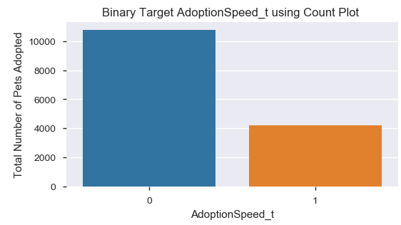
Data Wrangling Multifactorial Categorical variables
The target variable will have levels 0, 1, 2 and 3 binned into a 0-level.
Level 4 will be binned into the 1-level for animals that has been in the shelter for more than 100 days and were not adopted.
The binned Target variable results can be seen in the AdoptionSpeed_t Figure.

Slide 10
Data Wrangling multifactorial (cont.)
The Quantity ordinal variable had a total of 19 levels and range from 1 to 19 for this dataset. The greatest number of adoptions occurred when only one pet was listed at a time and this accounted for 11,565 of these adoptees and only 1,422 for two pets listed at a time. The Quantity variable will bin all animals that had 2 or more animals in a listing for group 2.
The Fee variable had a total of 74 unique values and high cardinality. This variable was binned into two categories. All animals that were adopted for free were placed into category 0 and those that were purchased for a dollar value were binned into level 1.
The State variable had a total of 14 nominal levels and 41326 accounted for a total of 8,714 of the pets and 41401 accounted for 3,845 of the pets. Number 41326 is from Selangor and 41401 is from Kuala Lumpur in Malaysia. The remaining 12 levels were merged into one group called 41000.

Slide 11
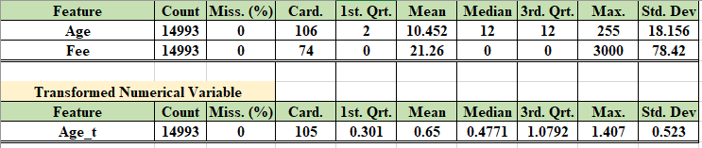
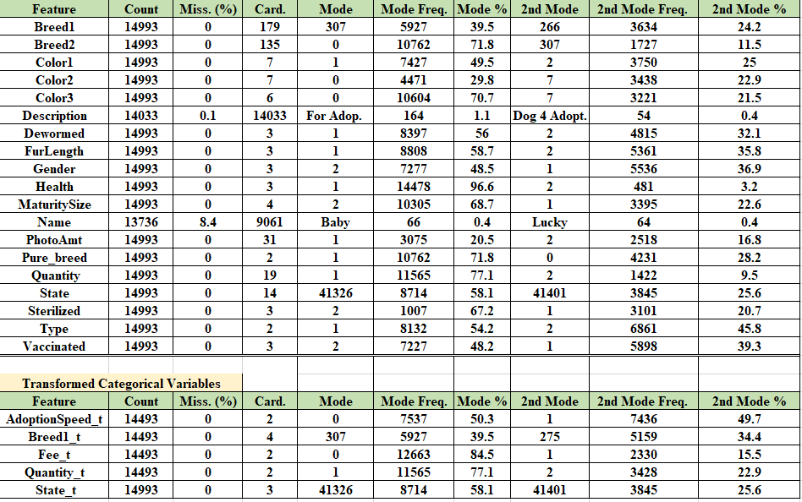
Data Quality Report

Slide 12
Model development
Model development is divided into three iterations. A base model was first generated from the Logistic Model using a 10-fold cross validation for the five-level target variable and the binary target variable.
The first iteration contains seven models to determine the best f1 results for the binned target variable and will include the original 17 input variables. These seven models are the Random Forest, KNN Neighbors, Logistic Regression, Extra Tree Classifier, Support Vector Machine, Ada Boost and Gaussian Process.
The second iteration will contain the binned target and the top nine variables selected by variable importance and logworth values. The data set was split into the training and validation test data with a 65:35 split for all models.
The final optimization step used hyperparameters from these seven models, the binary target variable and select eight input attributes. The best model will be selected based on f1 score and run again with a balanced approach and all 14,993 entries to generate the best score for this champion model.

Slide 13
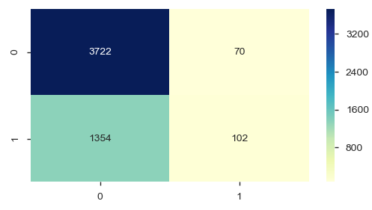
Model results
The Logistic Regression baseline model for the original multi-level target variable and all 17 original attributes accuracy score was 33.7%.
The Logistic Regression baseline model with the binary target and all 17 attributes f1 score was 13% and an accuracy score of 73%. The confusion matrix for the binary target variable is shown below.
Confusion Matrix

Slide 14
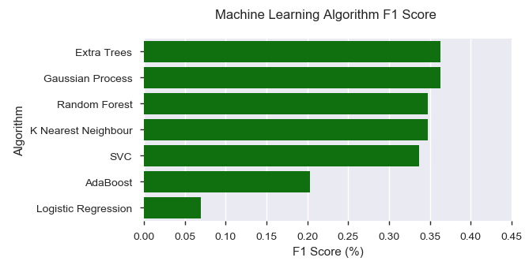
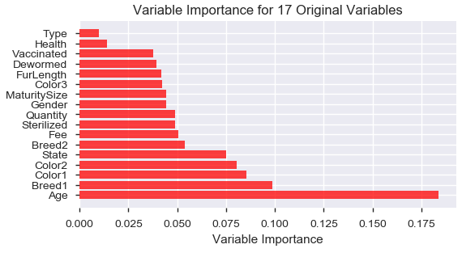
Model results (cont.)
The first iteration using all seven models with the binary target and 17 original attributes can be seen in Figures below. The average f1 scores ranged from 7% for the Logistic Regression
Model up to 36.3% for the Extra Trees Classifier.
F1 Scores
Variable Importance

Slide 15
Model results (cont.)
Nine attributes were used for the second optimization step. These attributes were selected on variable importance, Logworth values and R squared means.
These variables are Age_bin, Breed1, Color2, MaturitySize, State_t, FurLength, Fee_t, Quantity_t and Type.
The f1 scores ranged from 12.4% for Logistic Regression up to 37.2% for the Random Forest Model. Breed1 had the highest variable importance value of 23.1% and Age_bin was 22.2%.
The final optimization step removed the Type attribute to improve model performance and contained only eight input variables. All seven models included hyperparameters to increase model performance.
The AdaBoost and Random Forest models had the best results with f1 scores of 43.7% and 41.4%.

Slide 16
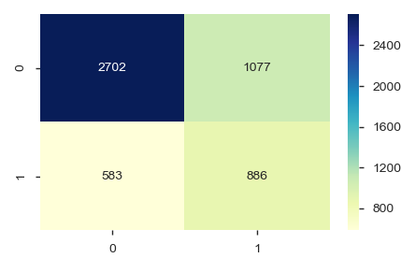
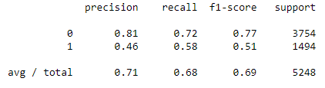
Model results (cont.)
Random Forest Model used the balanced approach with the Gini Index and had all 14,993 rows of data to generate the f1 score. The model’s f1 score increased to 52% compared to the 41% from the previous run. The Confusion Matrix and Classification Report.
Classification Report
Confusion Matrix

Slide 17
Lifeline survival models
The Lifeline Survival Analysis Model in Python was used on the binary target variable. The values were switched so Level 0 represented the animals that were not adopted and 1 represents pets that were adopted or was the event.
The Age variable was used for the duration column and the binary target variable was used for the event column.
Nine variables were selected for the final model. These variables are Gender, Color1, MaturitySize, FurLength, Vaccinated, Sterilized, Health, Quantity_t, Breed1_t and Type.
The summary report and Cox PH Fitter Plot shows a couple of attributes that had more of an impact for survival on this dataset.

Slide 18
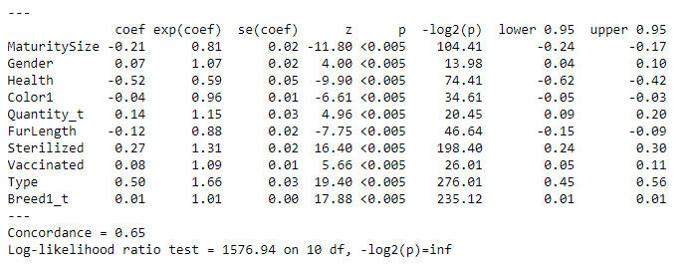
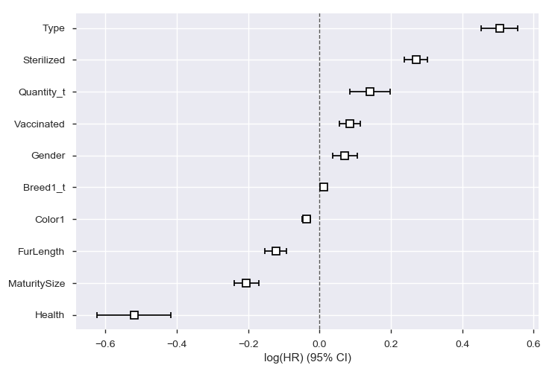
Lifeline survival results
Cox PH Fitter Summary Report
Cox PH Fitter Plot

Slide 19
Lifeline results
The Healthy individuals were much more likely to be adopted and were 97% of the data set compared to the minor and serious injured animals.
The MaturitySize of 3 and 4 (large or extra-large animals) stayed in the shelters longer than the small to medium sized dogs for this dataset. The extra-large pet’s probability of being adopted dropped from 40% down to 20% around 40 months of age and then leveled off and was consistent with the large breeds.
The Kaplan-Meier Plot (KMP) for variable Type shows that cats had a higher adoption rate from Age 2 to 100 months for the data set.
The Long Hair animals for FurLength was also least likely to become adopted from Age 2 until 90 months. This could be the result of the warmer climate in Malaysia or individual’s preference for specific breed types.

Slide 20
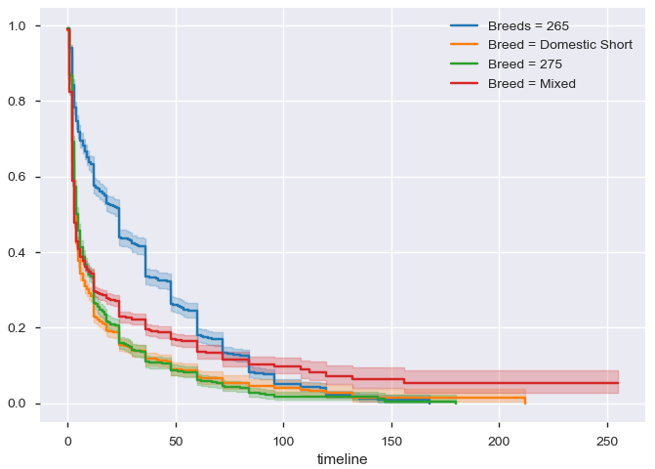
Lifeline results
The interesting note from the KMP Plot is Breed 265 which contains all dog breeds except 307. Bin 265 Breed was the least likely to become adopted until age 70 and then was more likely to become adopted compared to the 307 or mixed dog breeds.
These dogs had a total of 502 individuals between 10 and 25 months of age and 819 pets older than 25 months of age. This was 60% of the population for Breed 265.
KMP Plot for Breed1_t

Slide 21
Text analysis overview
Text analysis was completed on the Name attribute to determine if specific names had a greater chance of staying in the shelter longer than other pets. The standard text analysis procedures were performed for the Pet Adoption Dataset. These preprocessing steps are;
converting all words to lowercase and the removal of punctuation, whitespace, stop words and frequent words.
The top 35 most frequent words and least 10 common words were filtered from the data set to remove the majority of names like “baby” or “lucky.
The standard word frequency, TDIF, Polarity Scores were calculated and the Naïve Bayes Model was used with the binary target variable and the polarity scores, word length and word count for names.

Slide 22
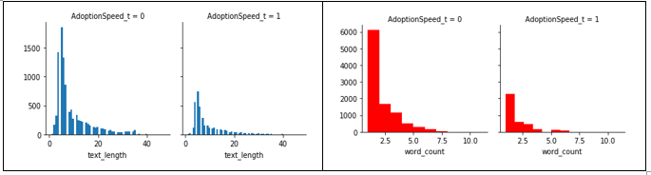
Text analysis results
The text length and word count values were calculated and are similar in their distribution for the binned AdoptionSpeed Target variables.
The text length of five was most frequent with 1,842 Names for AdoptionSpeed of 0 to 743 Names for AdoptionSpeed of 1.
The word count of one word was also most frequent with 6,088 Names for AdoptionSpeed of 0 to 2,287 Names for AdoptionSpeed of 1.

Slide 23
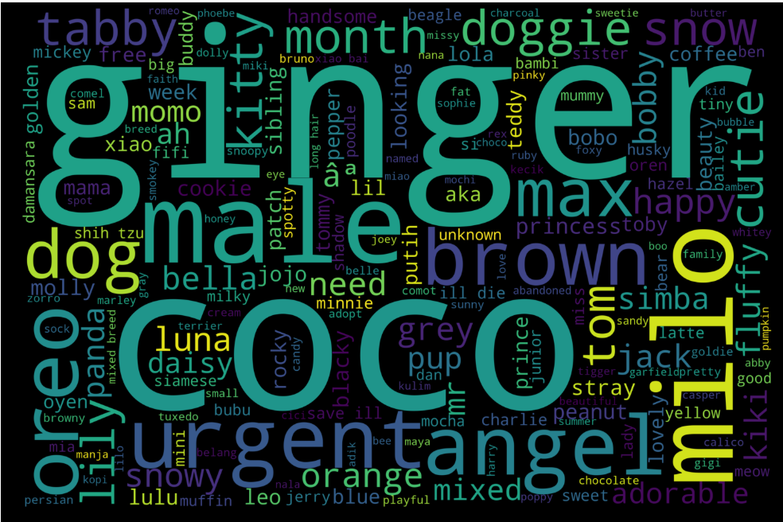
Text analysis results
The majority of the names from the data set have a polarity score of 0 and this accounts for 94.1% of the total Names.
There were only 532 names classified as a positive and 276 names as a negative sentiment.
The word cloud shows the distribution of the most frequent names like “coco”, “oreo” or “lulu”.

Slide 24
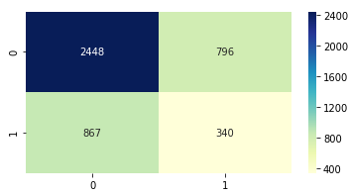
Text analysis results
The Naïve Bayes model was used on the preprocessed Name text to give a baseline model result to determine if Names are good predictors for Adoption rate success.
The baseline model had an accuracy score of 63% and a f1 score of 29% as shown in the confusion matrix.
The optimization steps included filtering by word and letter count with the Naive Bayes model. The accuracy values were in the 60% range and the f1 scores ranged between 26 to 33%.
Confusion Matrix

Slide 25
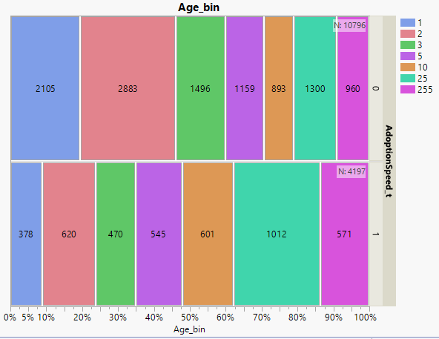
Discussion
Tree Map for Age_bin and AdoptionSpeed_t
Age_bin category came from animals that were older than 10 months and less than 25 months of age.
This age group will be targeted to increase adoption rates from the select shelters by implementing this new program called “Rescue Rebuild” which has shown to increase adoption rates by 25% (Huffpost, 2013).

Slide 26
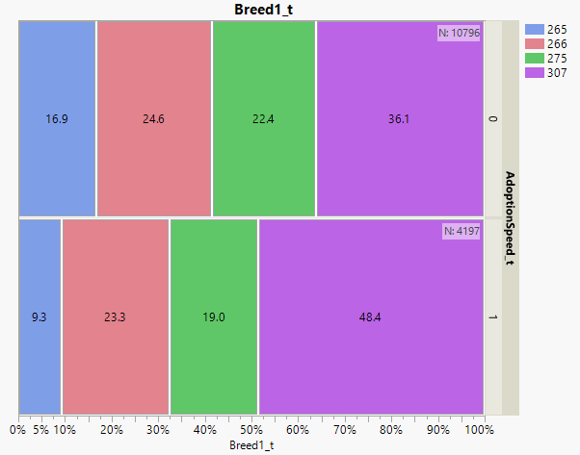
Discussion
Breed1_t categories 265, 266 and 275 slightly decreased in the percent of the total population of animals being adopted to not getting adopted except for Breed 307.
This mixed breed dog category actually increased from 36% that were adopted to 48% of the animals that were not being adopted in this study.
Tree Map for Breed_t and AdoptionSpeed_t.

Slide 27
Discussion
The goal is to implement two programs for the Breed1_t 307 Mixed Breed Dogs that were initiated from the Stony Brook University and is called the “Blog method” and Costa Rican Adoption organization in creating unique breed names specific to their genetic breed.
This study will randomly divide the mixed dog breeds into three categories which contain two treatments and the control group.
Treatment 1 will create a blog for the animal with a unique name specific to their genetic makeup and with a common one-word name.
Treatment 2 will contain a blog with only a common one-word pet name that is unique to that shelter and will be labeled as mixed breed.
The control group will not have a blog, will name the animals as mixed breeds and will use the current naming scheme.

Slide 28
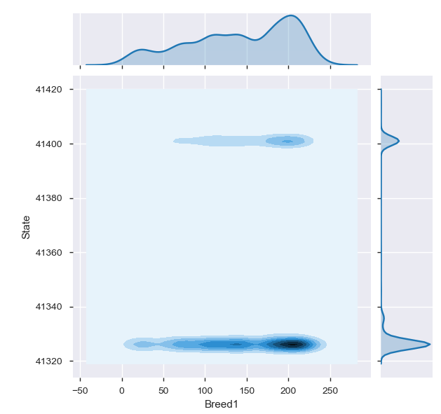
Discussion
The Breed1_t binned attribute number 265 had very interesting results for the dogs age and adoption rates. These dogs were older than 10 months of age and contained 1,302 out of the 2218 animals and 60% of these were adopted from the shelter and this can be seen in the Kaplan Meier-Plots.
The Breed1_t column was filtered to contain all dogs except 307 and the KDE plot was created in python for these dog breeds and the State. The density map shows a concentration of pets around Breeds 200 and between State values 41320 and 41330

Slide 29
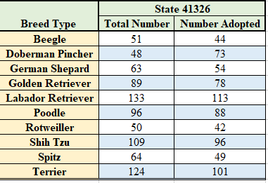
Discussion
Pandas crosstab was used to determine which breeds were the most adopted and from which state in the data set. The top 10 dog breeds figure shows State 41326 or Selangor, Malaysia is the location.
Selangor had a total of 1,359 of the 2218 dogs from the Breed1_t and about 60% of these older animals were adopted out of the shelter. These are common house breeds that were adopted more frequently compared to the mixed breeds for this age.
Top Ten Dog Breeds for Selangor

Slide 30
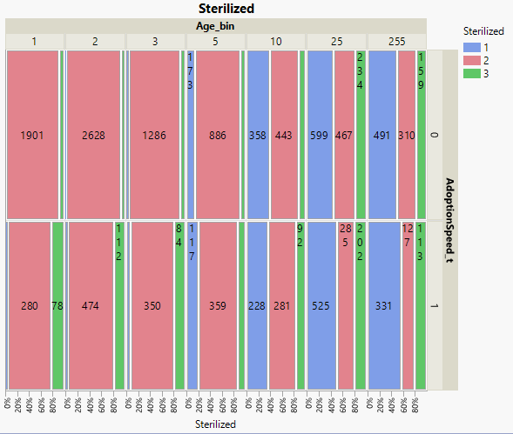
Discussion
Most pets were not sterilized until 10 months of age and was a significant variable in the Tukey comparison of means but was a weak predictor for the Random Forest Model.
There was a total of 4,527 small to medium sized animals and only 60% of this population actually was sterilized (1=Sterilization and 2 = Not Sterilized).
Sterilization is a common practice that should be implemented in the shelters to help reduce unwanted pets and increase longevity rates.

Slide 31
Conclusion
The best model to predict Pet Adoption rates with the f1 score is the Random Forest Model that uses the balanced approach and the Gini Index. The Accuracy results were 72% and the f1 Score was 52 % for the data set.
The mixed dog breeds from Breed 307 composed of 48.4 % of the Pets that were not adopted from this study and is another group that could benefit from a hybrid program that created a blog for each pet and generated a uniquely created name based on their genetic make up to attract potential donors.
The Text Analysis for the Name with the Naïve Bayes Model had accuracy values in the 60% range and low f1 scores ranging from 26 to 33% and was a poor predictor for adoption rates. The blog and naming scheme proposal will be implemented to determine if specific names can increase pet adoption rates.

Slide 32
References
Albon, C. (2018). Machine Learning with Python Cookbook, Practical solutions from
preprocessing to deep learning. O’Reilly Media Inc in Boston, First Addition.
Animal Farm Foundation. (ND). Naming Shelter Dogs: The Framing Effect. Retrieved from:
https://animalfarmfoundation.blog/2013/04/08/dog-names-framing/
ASPCA, (ND). ASPCA Research: Do Cat Names Affect Adoptability
Retrieved from: https://www.aspcapro.org/resource/saving-lives-
adoption- marketing-research-data/aspca-research-do-cat-names-affect
Davidson-Pilon, C. (ND). Lifelines. Retrieved from: https://lifelines.readthedocs.io/en/latest/
Crowe, E. (ND). Increasing Adoption Rates at Animal Shelters. Stony Brook University.
Retrieved fromhttps://xsrv.mm.cs.sunysb.edu/c4g/showcase/dogs%20with%20blogs.pptx

Slide 33
References
Foothills Animal Shelter. (ND). Services; Lost and Found Fees. Retrieved from:
https://foothillsanimalshelter.org/services/lost-and-found/fees/
Hastie, T., Tibshirani, R. and Friedman, J. (2017). The Elements of Statistical Learning: Data
Mining, Inference and Prediction. Springer Series in Statistics, 2nd Edition.
Huffpost, (2013). Mixed Breed Dog Adoption Campaign Gives Lovable Pooches New, Unique
Breed Names. Environment Section.
Retrieved from: https://www.huffpost.com/entry/mixed-breed-dog- adoption_n_3869267?guccounter=1&guce_referrer=aHR0cHM6Ly93d3cuZ29vZ2xlLmNv bS8&guce_referrer_sig=AQAAAKEJYS7Dqs7CWUbiEhU7u7WUZn- CoFmqQMeiTJAsyyexkHCsvAsgpYtHbf3S_wepcwnsUAkvlcuxeZZTCqG6N5ntnL7h9Jg uz7c6BGct5eqiYIdKuUYIBaIcVSE4buNl15mufdCKRcZNFtWoFJmN_GVRLTRBDPkdw Ipi132CQm9s

Slide 34
References
Kelly, J. (ND). Pet Adoption Fees Explained. PETMD Care. Retrieved from:
https://www.petmd.com/dog/care/evr_dg_dog_adoption_fees_explained
Merriam-Webster. (ND). Retrieved from:
https://www.merriam-webster.com/dictionary/name
Purina. (2013). Nestle Purina completes acquisition of Petfinder. Retrieved from:
http://newscenter.purina.com/2013-07-15-Nestle-Purina-completes-acquisition-of- Petfinder

